Slide 1

INT247 Machine Learning Foundations
Lecture #6.0 & 6.1
Dimensionality Reduction

Slide 2
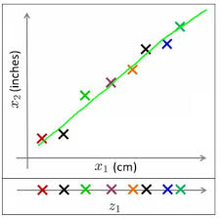
Dimensionality Reduction
Finds a low-dimensional representation of the data that retains as much information as possible.
Eg: two dimensions x1 and
x2 converted into one
dimension i.e z1.

Slide 3
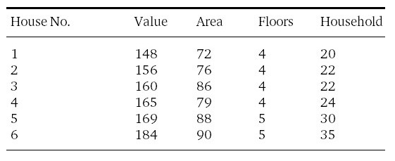
Getting rid of Unnecessary

Slide 4
Getting rid of Unnecessary
Can you characterize each house by its floor count?
No, as they have low variance, σ²=0.2
Can you characterize each house by its households?
May be, as its variance is σ²=28
Area has the variance 43.
Value has the variance 127
So, Area and Value are more representative than other two features.

Slide 5
Getting rid of Unnecessary
What about the relation between features?
Value is roughly double the Area.
i.e. covariance is high in between Area and Value.
Higher the covariance, the more correlated the two features are, which implies redundancy in the data.

Slide 6
Discussion
It’s a good thing to have features with high variance, since they will be more informative and more important.
It’s a bad thing to have highly correlated features since they can be deduced from one another with little loss in information.

Slide 7
Why Dimension Reduction is Important?
More variables, more trouble.
Relevant/irrelevant variables.
Is there any algorithm which can identify the most significant variable?

Slide 8
Different Methods of Dimensionality Reduction
Feature Selection (Data Preprocessing)
Feature Extraction: summarize the information of a dataset by transforming it onto a new feature subspace of lower dimensionality.

Slide 9
Dimensionality Reduction via Feature Extraction
Principal Component Analysis (PCA): unsupervised data compression
Linear Discriminant Analysis (LDA): supervised technique for maximizing class separability.
Kernal Principal Component Analysis: Nonlinear Dimensionality Reduction

Slide 10
Principal Component Analysis
Unsupervised linear transformation technique
Identify patterns in data based on the correlation between features.
Aims to find the directions of maximum variance in high dimensional data and projects it onto a new subspace with equal or fewer dimensions.

Slide 11
Steps of PCA
Standardize the d-dimensional dataset.
Construct the covariance matrix.
Decompose the covariance matrix into its eigenvectors and eigenvalues.
Select k eigenvectors that correspond to the k largest eigenvalues, where k is the dimensionality of the new feature space (k<=d).
Construct a projection matrix W from the “top” k eigenvectors.
Transform the d-dimensional input dataset X using the projection matrix W to obtain the new k-dimensional feature subspace.

Slide 12
PCA
After transformation:
The first principal component will have the largest variance.
All principal components will have largest possible variance given that they are uncorrelated to the other principal components.
PCA directions are highly sensitive to data scaling, so features must be standardized prior to PCA.

Slide 13


